Slide 1

STORYTELLING

Slide 2
GETTING STARTED (WARMING UP)
https://youtu.be/1RYByws56TQ
The Legend of Weesakayjack - First Nation Legend - How North America came to be
Listening For Social Interaction
The teacher shall ask students to develop a list of attributes of a good listener. Discuss the list. Listen to each other's comments on the art of listening! After watching the video the students will be given time to discuss the story in their groups (groups of four students each)
Ask students to offer encouragement to a speaker by showing in non-verbal terms with their eyes, facial expression, and body stance that they are listening. This social courtesy creates an atmosphere where speakers will generously speak. Ask students to assess their own listening skills. Students to contemplate if they always pay complete mental attention to speakers or do they observe their mind straying to other irrelevant thoughts. Only the student can assess his or her own concentration patterns.

Slide 3
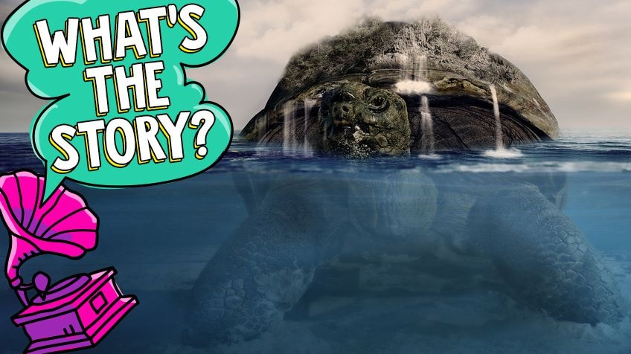
TURTLE ISLAND :
The turtle in First Nations creation stories.

Slide 4
TURTLE ISLAND
Turtle Island might sound like some far away island in the sea, but it's actually what some Indigenous people call the continent of North America, while others, such as the Ojibwa, use it to refer to the whole world.
The name Turtle Island comes from First Nations. Depending on the storyteller the story is different, but they mostly agree that the turtle is part of the creation story (a story about how everything came to be).
Some Nations believe that the Creator of all things flooded the Earth because the people couldn’t get along and were fighting. In one version, only the animals and Nanabush (or Nanabozho), a spirit that appears in many Ojibwa (say “oh-JIB-wah”) legends, survived. He has an Anishinaabe (say "uh-NISH-ih-NAH-bay") mother and a spirit father, so he is half spirit and half human.
Here's how one creation story, based on an Ojibwa version, goes: When the Creator flooded the Earth, Nanabush was left floating with the animals. He had the amazing idea to dive down to the bottom of the water and bring back some earth to create new land. Nanabush dove down into the water over and over but no matter how hard he tried, he couldn’t reach the bottom. When he grew too tired, animals that were used to diving down into the water tried.

Slide 5
TURTLE ISLAND
The loon tried to reach the bottom, but the water was too deep. When he was too tired, the turtle tried. But he couldn’t reach the bottom either. Finally there was no one left to take a turn.
The muskrat came forward and offered to try. The other animals laughed at him because he wasn’t used to diving. But the muskrat took a deep breath and dove down into the water. The other animals and Nanabush waited. They looked in the water for the muskrat. But the muskrat didn’t appear. They waited a very long time and had given up when they finally saw the muskrat! They rushed to him as he breathed his last breath. As the muskrat died, they noticed that he was clutching earth that he had brought up from the water.
The turtle told them that if the muskrat was willing to give his life, then he could give them his shell. They could put the earth that the Muskrat had brought them on his back and he would carry it for them. The winds blew and spread the earth around. That little bit of earth that the Muskrat had brought back became Turtle Island.

Slide 6
Did you know many cultures all over the world celebrate turtles? In African stories, the turtle is the smartest animal. In Chinese mythology, the turtle is a very powerful symbol. And in Tahiti, the turtle is the lord of the oceans.
FACTS FOR ALL TO VERIFY AND MORE…….

Slide 7
Storytelling Activities to Support the standards for English Language Arts
After Telling the Folktale to the Class.
Inquiries related to who, what, where, or when.
Who: Name the main characters.
What: Describe one action that a character in the tale did.
Where: Describe a detail mentioned in the story that refers to the setting of the tale.
When: Make a linear timeline of the sequence of events of the plot.

Slide 8
FOLLOW UP ACTIVITIES
Students to interview elders in their family to explore collecting family stories..
Students to gather in small discussion groups to develop a group project such as a short skit based on a folktale.
Students can further ask questions and build on this story with some quotes and new words that they learned.
Having students orally share stories: by retelling folk tales.or reading a folktale out loud with expression in the next class.
Students to give an oral book report.
Have students create and present a first person monologue pretending to be a famous figure out of history.
Students may speak to each other about experiences in their lives that resemble incidents in the tale.

Slide 9
THE ONGOING ACTIVITY………….
Listen to the audio story
Click on the link
https://www.rcaanc-cirnac.gc.ca/DAM/DAM-CIRNAC-RCAANC/DAM-PPLCOM/STAGING/audio-audio/lr_ks_TLR_1367343325070_eng.mp3
listen to the sequence and be ready with one story to narrate in their group.

Slide 10
CONVERSATION PARTY SALON
The students would now be given 15 minutes to gather in their groups and discuss an interesting aspect of the story.
Listen to the folktales as ancient as this. Decipher and discuss a useful bit of wisdom that the plotline preserved for future generations.
Invent a different way to retell the folktale in written form from the point of view of one of the characters as a:
Diary entry (communication to one's self)
Newspaper report (a public communication)
Letter to a friend (a communication to a trusted associate)

